Slide 1
Interaction Design
CSE-282 Human-Computer Interaction
Dr. Mohamed M. Saad

Slide 2

Terminology & Basic Concepts
What is the goal of this lecture?

Slide 3
Interaction
Design

Slide 4
Interactive Products
How many interactive products are there in everyday use?
Ex: iPad, Smart Phone, TV, Clock alarm, ATM, Websites
What do you think about their usability?
Why there is a difference?
Usability vs Functionality
Goal: “Design products that are easy, effective, and pleasurable to use”
Notes:
Usability : mot3t w sahola ast5dam al 7aga
Functionality : al action elly al device bi3mlo

Slide 5
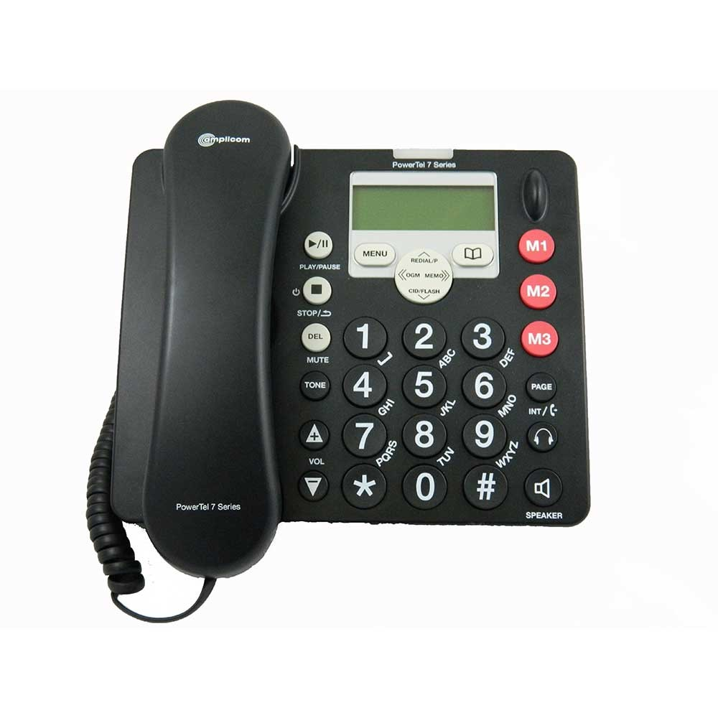
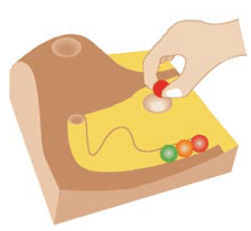
Poor & Good Designs
VS.
https://vimeo.com/183465991
Notes:
Step1: beeb beeb beeb
Step2: Touch 41 to go to the system
Step3: Touch*, your room number, and #
Step4: Enter Password. What password?
Step5: Touch 5, then enter room number, or Touch 9 to
The marble answering machine, 1995
Problems:
Cost
Security
Marbles are lost or stolen

Slide 6
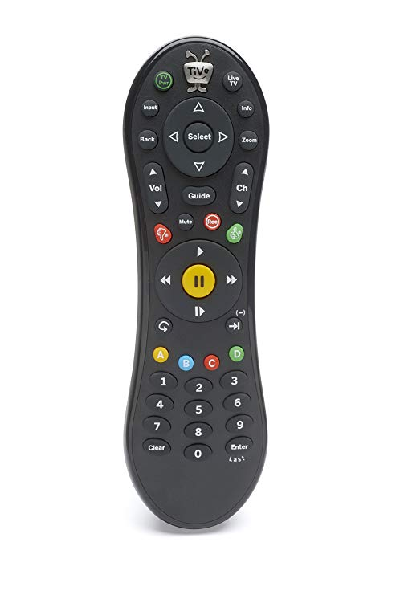
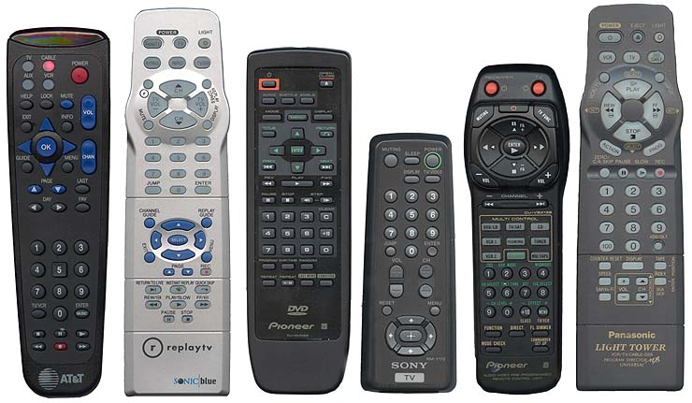
Poor & Good Designs
VS.
1 2 3 4 5 6 7
Notes:
TiVo remote control → User intervention

Slide 7
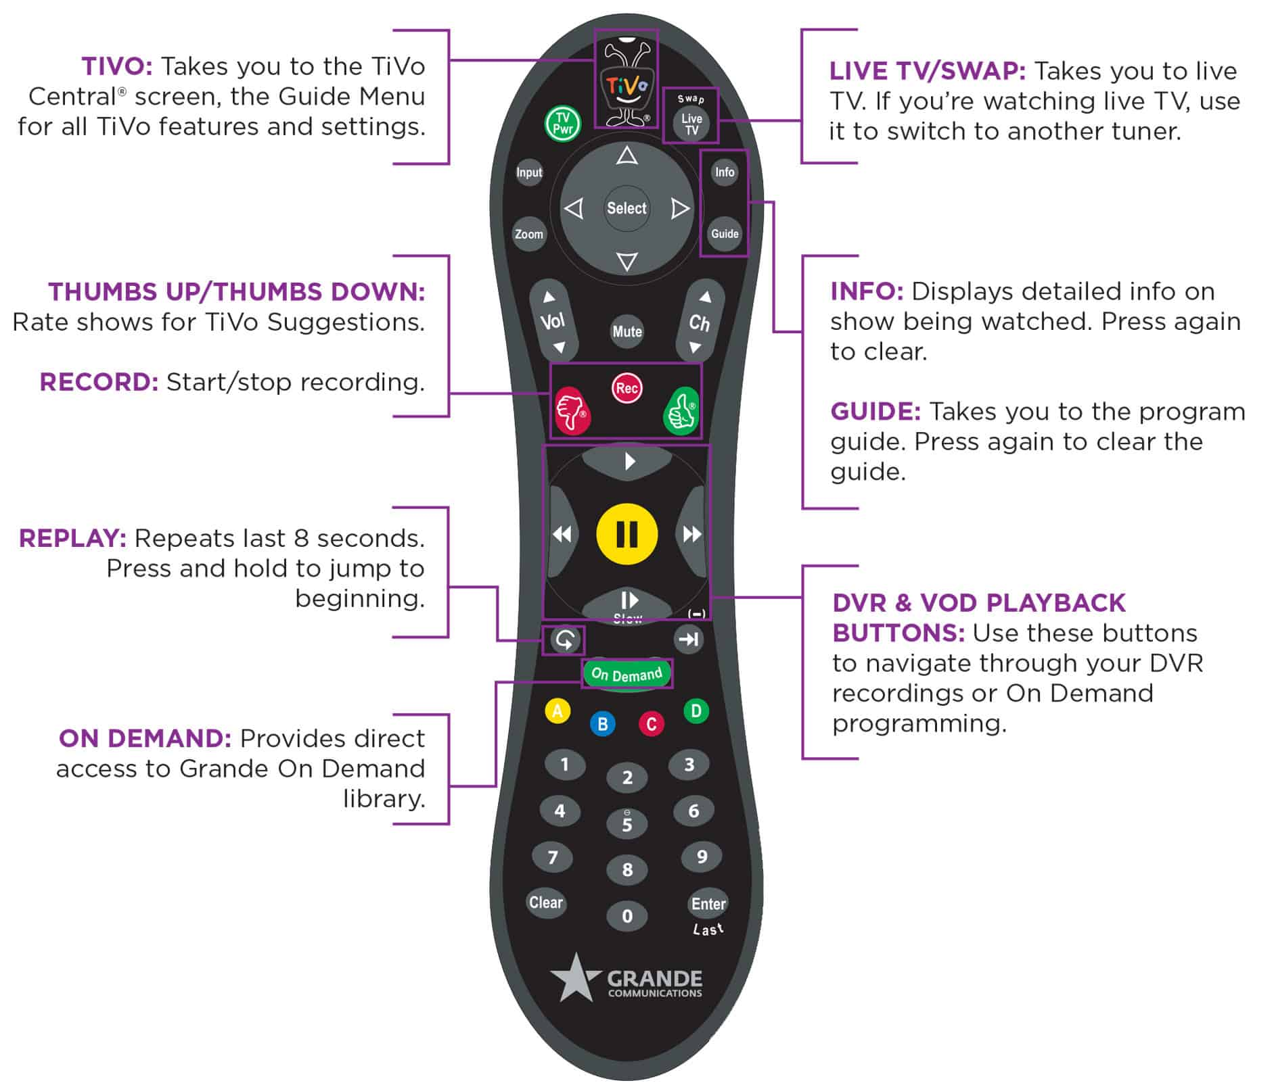
Poor & Good
Designs

Slide 8
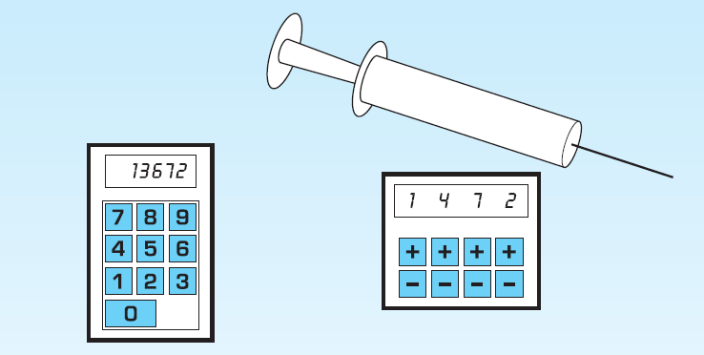
Poor & Good Designs
Notes:
User intervention
Problem: 10x the dose if error in typing
Elly fih 4 digits hikon a7sn

Slide 9
Interactive Design
“Designing interactive products to support the way people communicate and interact in their everyday and working lives”
“The design of spaces for human communication and interaction”
How this is different from other methods such as “Software Engineering”?
Notes:
Civil Engineer vs Architect
Architect: Is there the right mix of family and private spaces? Are the spaces for cooking and eating in close proximity? Will people live in the space being designed in the way it was intended to be used?
Civil Engineer: Cost, durability, structural aspects, environmental aspects, fire regulations, and construction methods

Slide 10
Interactive Design
Listen ... Think ... Try ...
Who is going to be using?
How they are going to be used?
Where they are going to be used?
Goal: “Optimize the users’ interactions with a system, environment, or product, so that they support and extend the users’ activities in effective, pleasurable, useful, and usable ways”
Notes:
What people are good and bad at?
Listening to what people want
Using tried and tested user-based techniques

Slide 11
Interactive Design
Why?
Transforming human–human transactions into solely interface-based ones Examples: Self-checkouts at grocery stores, airports, and libraries
Extend the users’ activities in effective, pleasurable, useful, and usable ways Examples: cameras, microwave ovens, and washing machines
Notes:
Computer-based systems: send messages, gather information, write essays, control power plants, program, draw, plan, calculate, monitor others, play games
Interactive devices: multitouch displays, speech-based systems, handheld devices, and large interactive displays
Towards transforming human–human transactions into solely interface-based ones
Interfaces: cameras, microwave ovens, and washing machines, Self-checkouts at grocery stores, airports, and libraries

Slide 12
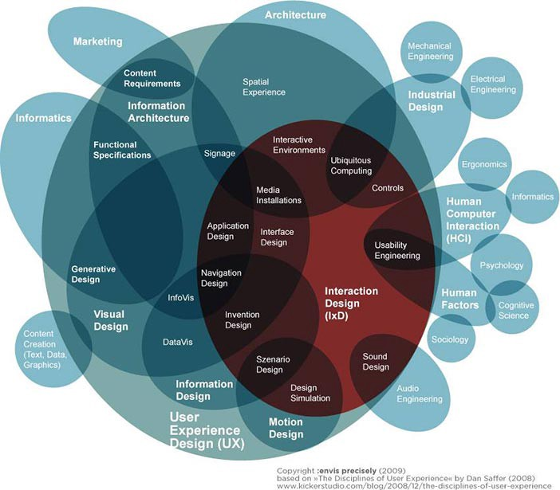
Human-Computer Interaction (HCI)
“The design, evaluation, and implementation of interactive computing systems for human use and with the study of major phenomena surrounding them”

Slide 13
Design
Principles

Slide 14
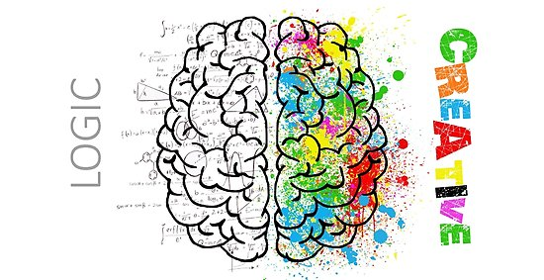
Who is involved
Developers
Understand
The business side,
The technical side,
The manufacturing side
Designers
How people act and react to events?
How they communicate and interact with each other?
How emotions work?
Create engaging user experience
How easy is it to work in multidisciplinary teams?
Notes:
Cost!?
The more people there are with different backgrounds in a design team, the more difficult it can be to communicate and make progress forward with the designs being generated

Slide 15
Design Principles
Generalizable abstractions intended to orient designers towards thinking about different aspects of their designs.
Visibility
Feedback
Constraints
Mapping
Consistency
Affordance

Slide 16
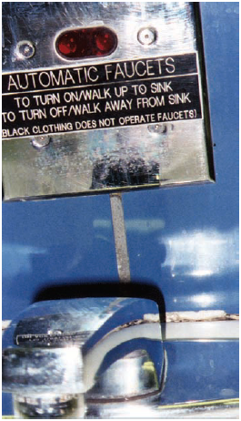
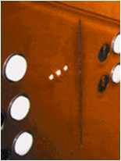
Design Principles
Generalizable abstractions intended to orient designers towards thinking about different aspects of their designs.
Visibility
Feedback
Constraints
Mapping
Consistency
Affordance
Notes:
3 no2t al so8irin dol homa al buttons

Slide 17
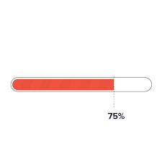
Design Principles
Generalizable abstractions intended to orient designers towards thinking about different aspects of their designs.
Visibility
Feedback
Constraints
Mapping
Consistency
Affordance

Slide 18
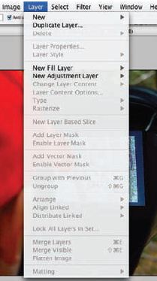
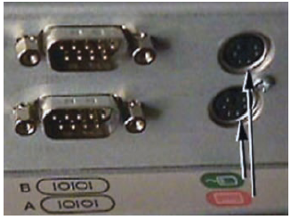
Design Principles
Generalizable abstractions intended to orient designers towards thinking about different aspects of their designs.
Visibility
Feedback
Constraints
Mapping
Consistency
Affordance

Slide 19

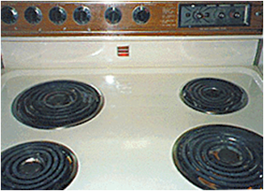
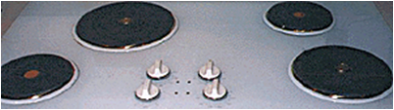
Design Principles
Generalizable abstractions intended to orient designers towards thinking about different aspects of their designs.
Visibility
Feedback
Constraints
Mapping
Consistency
Affordance

Slide 20
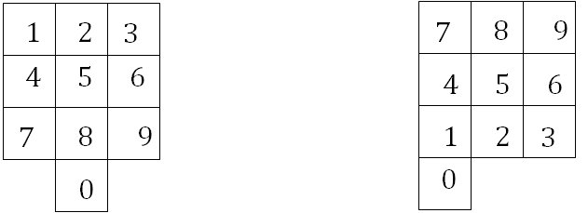
Design Principles
Generalizable abstractions intended to orient designers towards thinking about different aspects of their designs.
Visibility
Feedback
Constraints
Mapping
Consistency
Affordance
(a) phones, remote controls
(b) calculators, computer keypads

Slide 21
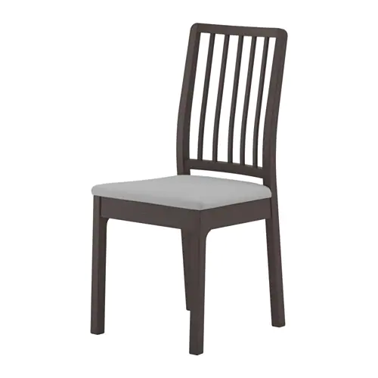


Design Principles
Generalizable abstractions intended to orient designers towards thinking about different aspects of their designs.
Visibility
Feedback
Constraints
Mapping
Consistency
Affordance (perceived and real)

Slide 22
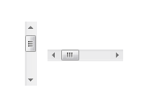


Design Principles
Generalizable abstractions intended to orient designers towards thinking about different aspects of their designs.
Visibility
Feedback
Constraints
Mapping
Consistency
Affordance (perceived and real)

Slide 23
User Experience

Slide 24
User Experience (UX)
“How a product behaves and is used by people in the real world. How people feel about a product and their pleasure and satisfaction when using, looking at, holding, opening or closing it.”

Slide 25

User Experience (UX)
Every product that is used by someone has a user experience: newspapers, ketchup bottles, reclining armchairs, cardigan sweaters
Positive experiences drive curiosity. They help motivate us to grow as individuals.
Negative experiences help us prevent repeated mistakes.

Slide 26
User Experience (UX)
Watch the small details!!
How smoothly a switch rotates
The sound of a click
The touch of a button when pressing it
The colors selection
The weight of the device
….

Slide 27
User Experience (UX)
Factors of UX are
Usability
Functionality
Aesthetics / Look and feel
Content
Emotional appeal (Norman’s model: visceral, behavioral, reflective)

Slide 28
Norman’s model
Visceral Users’ gut reactions to or their first impressions of your design; e.g., an uncluttered user interface suggests ease of use.
Behavioral Users subconsciously evaluate how your design helps them achieve goals, and how easily. They should feel satisfied that they’re in control, with minimum effort required.
Reflective After they encounter your design, users will consciously judge its performance and benefits, including value for money. If they’re happy, they’ll keep using it, form emotional bonds with it and tell their friends.

Slide 29
User Centered Design

Slide 30
Interaction Design Approaches
User
Centered
Activity
Centered
System
Genius
User Knows the best
User is the only guide
User Behavior is captured
User set the goals of the system
Based on creativity and experience
Designer's role is to translate the user needs and goals into the system solution
User is important but his behavior not their needs and goals
Structured, Rigorous, and Holistic
User only validates the ideas generated by the designer
Notes:
Apple follows Genius Design Approach with low user research

Slide 31
Interaction Design Approaches
User
Centered
Activity
Centered
System
Genius
User Knows the best
User is the only guide
User Behavior is captured
User set the goals of the system
Based on creativity and experience
Designer's role is to translate the user needs and goals into the system solution
User is important but his behavior not their needs and goals
Structured, Rigorous, and Holistic
User only validates the ideas generated by the designer
Notes:
Apple follows Genius Design Approach with low user research

Slide 32
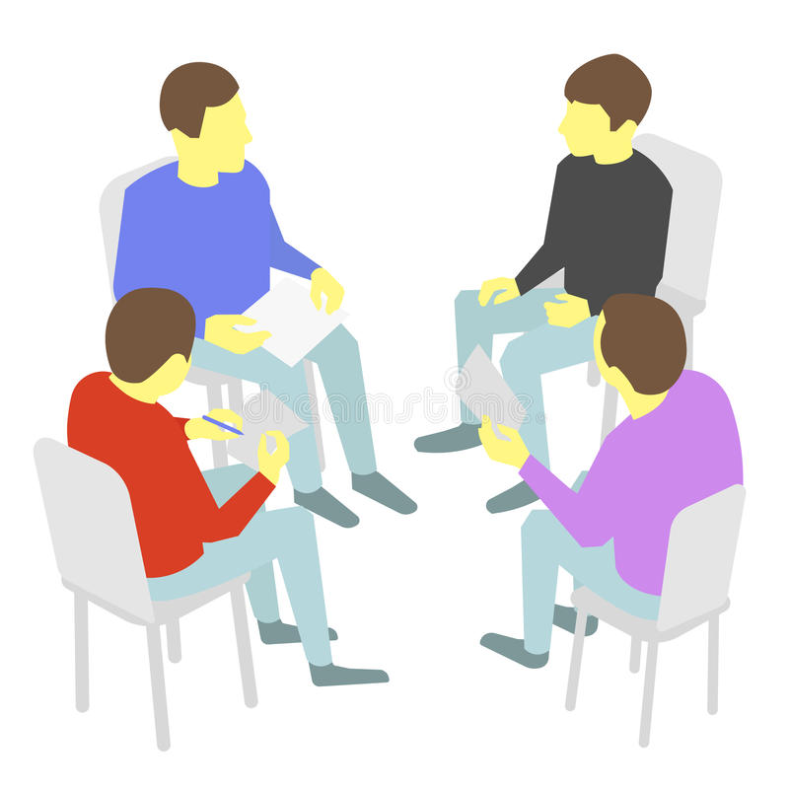

User Intervention
Involving Users in Design (Prototypes)
Expectation Management (Disappointment = Expectation / Reality)
Ownership
Co-Opted
(Partime/Fulltime, Short/Long Period)
Newsletters (Seminars & Workshops)
Notes:
Eliminate Proxy Users

Slide 33
Who are the users?
Identifying the users is not straightforward !
Primary Users
are those likely to be frequent hands-on users of the system
1
Secondary Users
occasional users or those who use the system through an intermediary
2
Tertiary Users
are those affected by the introduction of the system or who will influence its purchase
3
Notes:
Who are the users in the following systems:
Check-out system in markets
ATM
Recommendation System
Online Market for Selling Flowers

Slide 34
User-Centered Design
Goals & Tasks
Behavior and Context of use
Users Characteristics
size of hands, length, age, attention, memory, and perception height, mobility, and strength Disabilities (e.g,, color blindness)
What and how user does his/her job
priorities, preferences, and implicit intentions
1
2
3
Notes:
A good example on user characteristics is kids toys

Slide 35
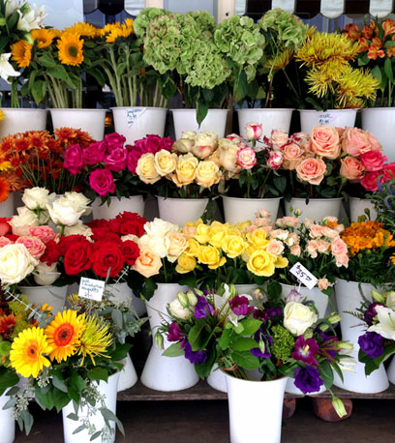

Practical Exercise
Design an online shop for selling flowers using the user-centered approach.
Find out who are your three types of users for your online flower store

Slide 36
Problem
Space

Slide 37
Identify the Problem Space
Are there problems with an existing product or user experience?
If so, what are they?
Why do you think there are problems?
How do you think your proposed design ideas might overcome these?
If not, and instead are designing for a new user experience,
how do you think your proposed design ideas support, change, or extend current ways of doing things?

Slide 38
Understanding the Problem Space
Assumption
Taking something for granted when it needs further investigation
Claim
Stating something to be true when it is still open to question

Slide 39
Use Case
3D TV
Assumptions
People would not mind wearing the glasses
Paying a lot more
Claims
Really enjoy the enhanced clarity and color detail provided by 3D
Unknows
Is it actual desired living room experience?
Curved TV
Assumptions
More flexibility for viewers to optimize the viewing angle
Claims
Big families will like the new display experience
Unknows
Is it actual desired living room experience?

Slide 40
What do we mean by “Needs”?
People don’t necessarily know what is they need
We need to study their characteristics and capabilities
What they are trying to achieve?
How they achieve it currently?
Can we achieve that more effectively or with more enjoyable experience ?

Slide 41
What do we mean by “Needs”?
‘un-dreamed-of’ Need
People don’t necessarily know what is possible
If you had asked someone in the street in the late 1990s what is needed from phone?
If you asked someone now what is needed from clothes or glasses?

Slide 42
References
Chapter 1, “Interactional Design”, 4th edition
Emotional Design https://www.interaction-design.org/literature/topics/emotional-design
The marble answering machine https://vimeo.com/183465991
Affordance https://www.youtube.com/watch?v=pAOyWFOFhsg

Slide 43
Home Exercise 1.1 [1 point]
Find some products that didn’t consider the following design principles
Consistency
Constraints
Affordance (watch this video https://www.youtube.com/watch?v=pAOyWFOFhsg)

Slide 44
Home Exercise 1.2 [1 point]
Read the following article https://www.interaction-design.org/literature/article/bad-design-vs-good-design-5-examples-we-can-learn-frombad-design-vs-good-design-5-examples-we-can-learn-from-130706 Then visit http://www.baddesigns.com/examples.html and pick any example to demonstrate it in the next lecture

Slide 45
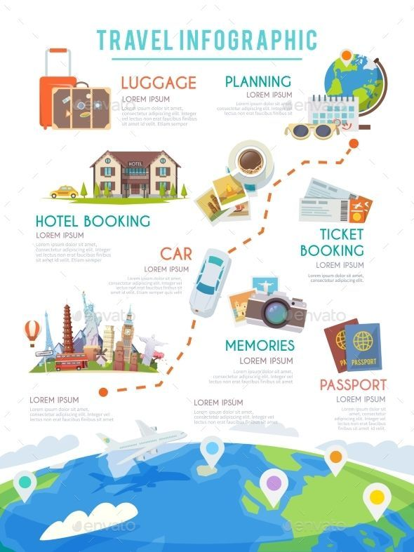
Home Exercise 1.3 [1 point]
Design a traveller planner web-site.
Who are your three types of users
Define the system goal?
What are user tasks?
Notes:
Is it business or vacation?
Plan your route
Check visa requirements
Book flights or train tickets
Investigate the facilities at your destination

Slide 46
Home Exercise 1.4 [1 point]
What could be an “un-dreamed-of” need in you online flower store?

